Slide 1


ALY6110
Data Management and Big Data
Module 6: FINAL PROJECT REPORT
By Group 4
Sameeksha Santhosh
Shradha Siddam Shetty
MPS Analytics – ALY 6110
Professor: Daya Rudhramoorthi
October 28th , 2023

Slide 2
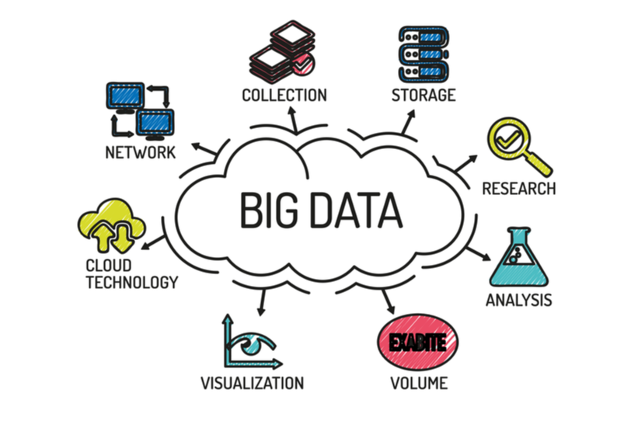
INTRODUCTION TO BIG DATA AND DATA SET
The Role of Big Data in T20 Cricket Challenges
About Dataset
The ball_by_ball_it20.csv file is an extensive dataset encompassing intricate details from T20 International (T20I) cricket matches. It offers a comprehensive overview of every facet of T20I matches, encompassing vital attributes for each match played in this format.
Introduce big data as a game-changer in the world of cricket, providing data-driven solutions for optimizing player performance, team strategies, and match outcomes.
Notes:
1. It is an enormous volume of data, both structured and unstructured, that is generated at a rapid pace. It requires advanced processing techniques to derive meaningful insights and is integral for informed decision-making and innovation in various sectors.

Slide 3
REAL-TIME BUSINESS ANALYSIS
BUSINESS QUESTION
What factors influence a cricket team's performance in Twenty20 Internationals, and how can we use this information to enhance both team performance and fan engagement?
With big data analytics, this dataset can offer intricate insights into player strategies, team dynamics, and match-winning patterns.
Further Analysis
Performance Analysis
Match Statistics
Team Approach

Slide 4
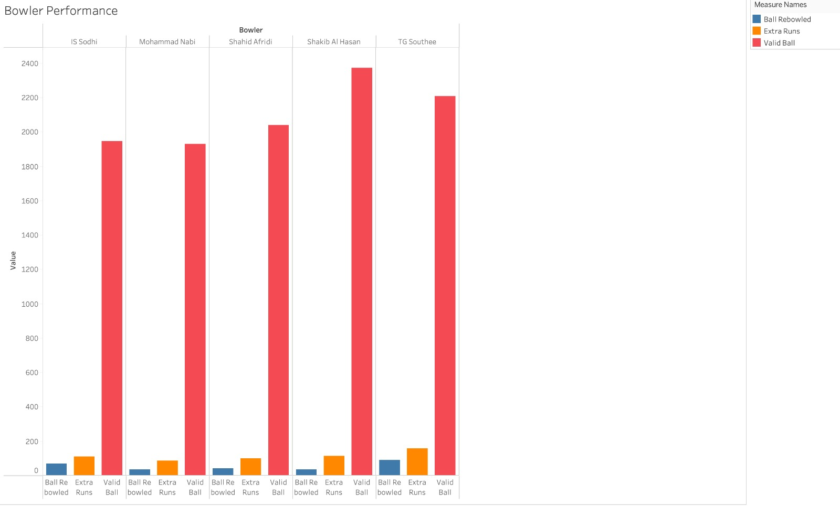
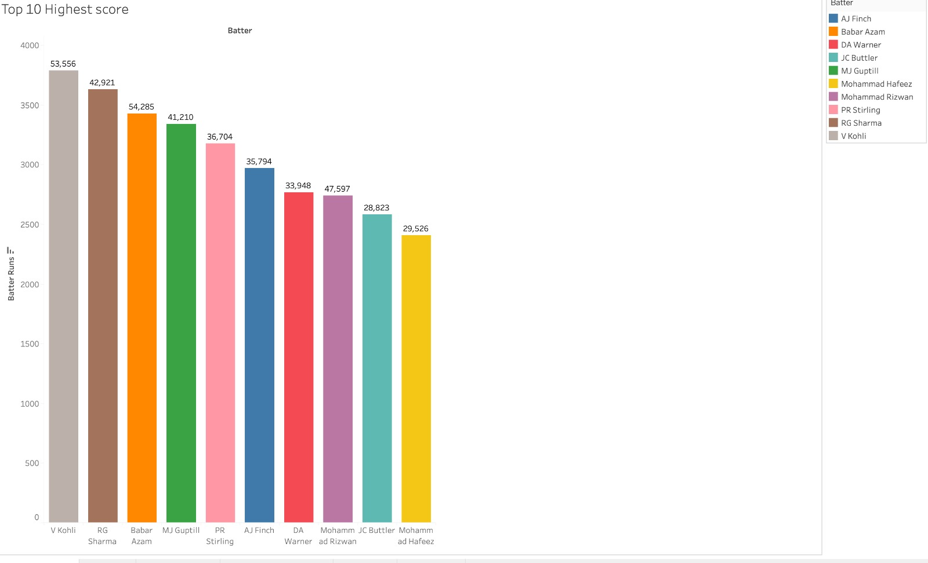

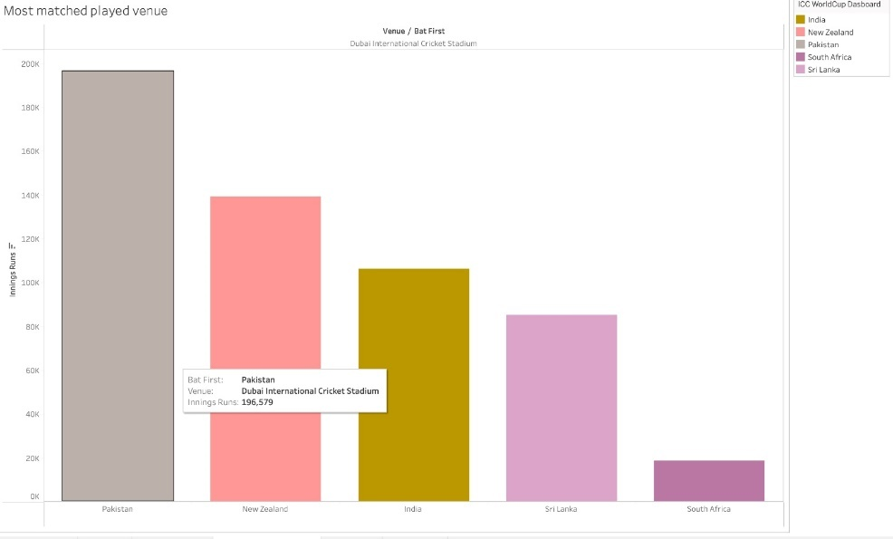
EDA – TABLEAU AND POWER BI
When examining the left graph, the first thing that catches the eye is the top run scorer leaderboard.
The bar chart provides information on bowlers' performances as one transition from batting to bowling.
Now that we're looking at the locations, the most well-known battlefield is the Dubai Cricket Stadium.
Lastly, a fascinating section explores the various methods of dismissal.

Slide 5
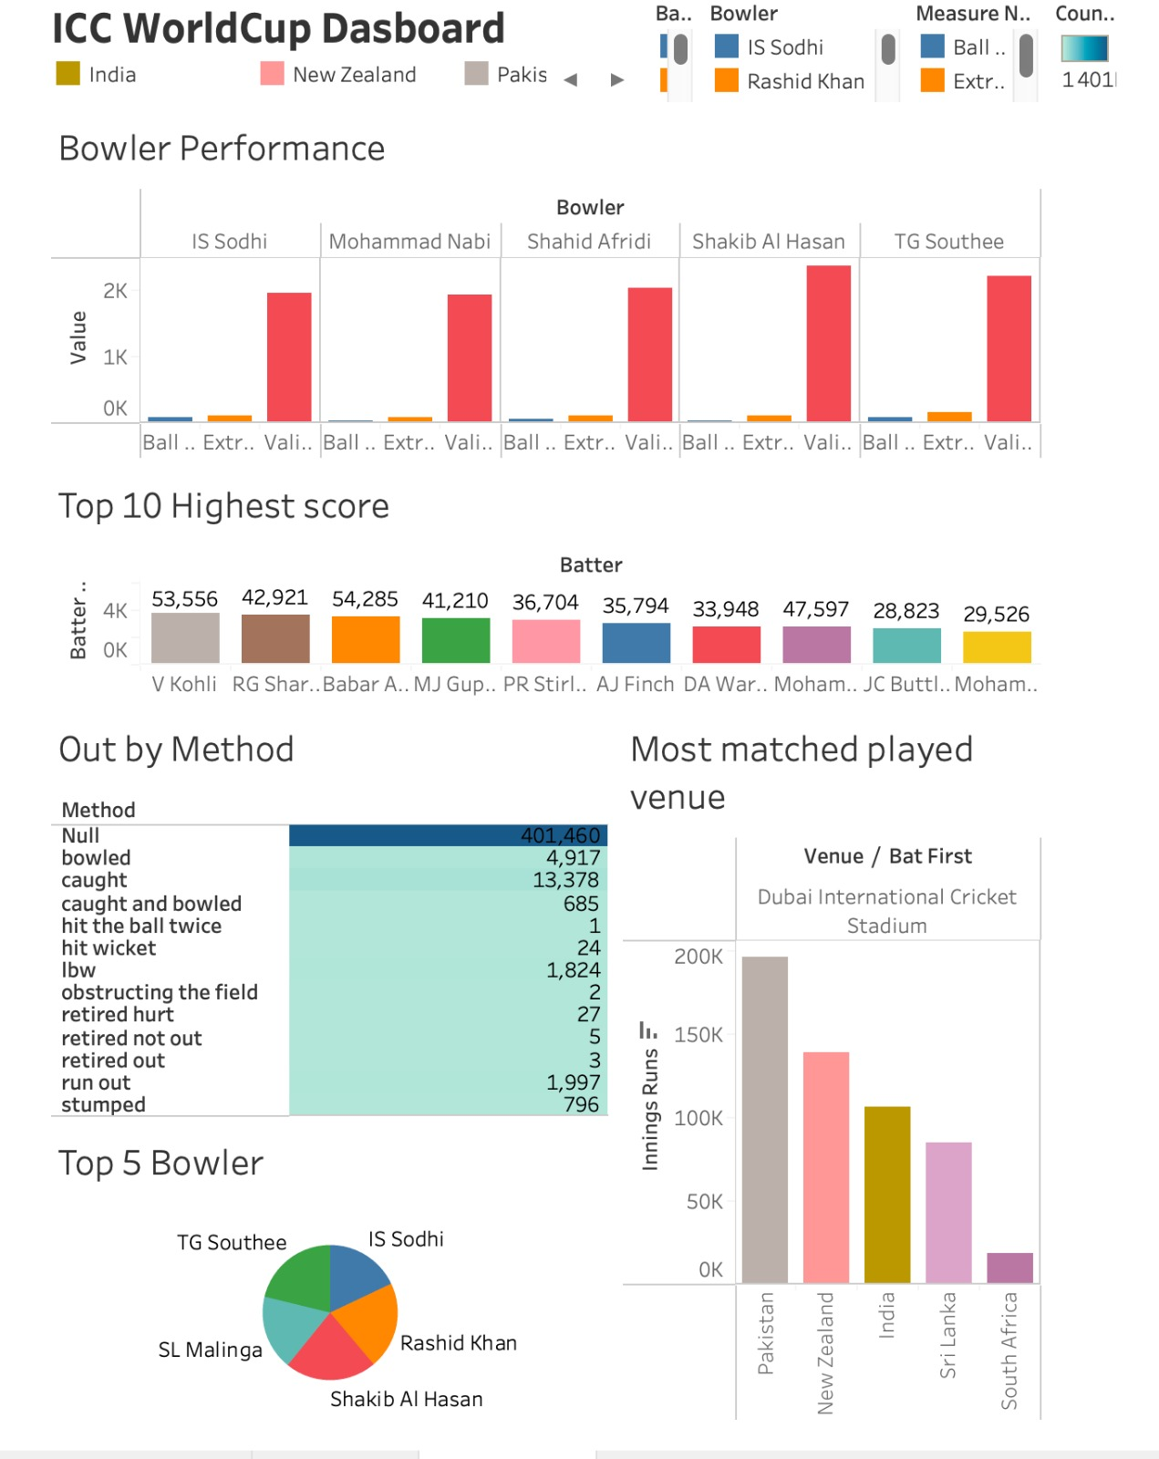
EDA – TABLEAU AND POWER BI

Slide 6
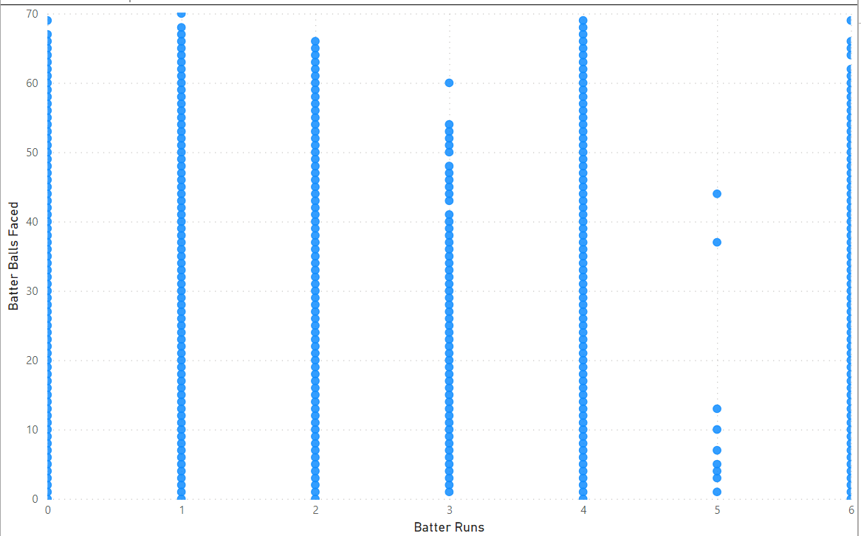
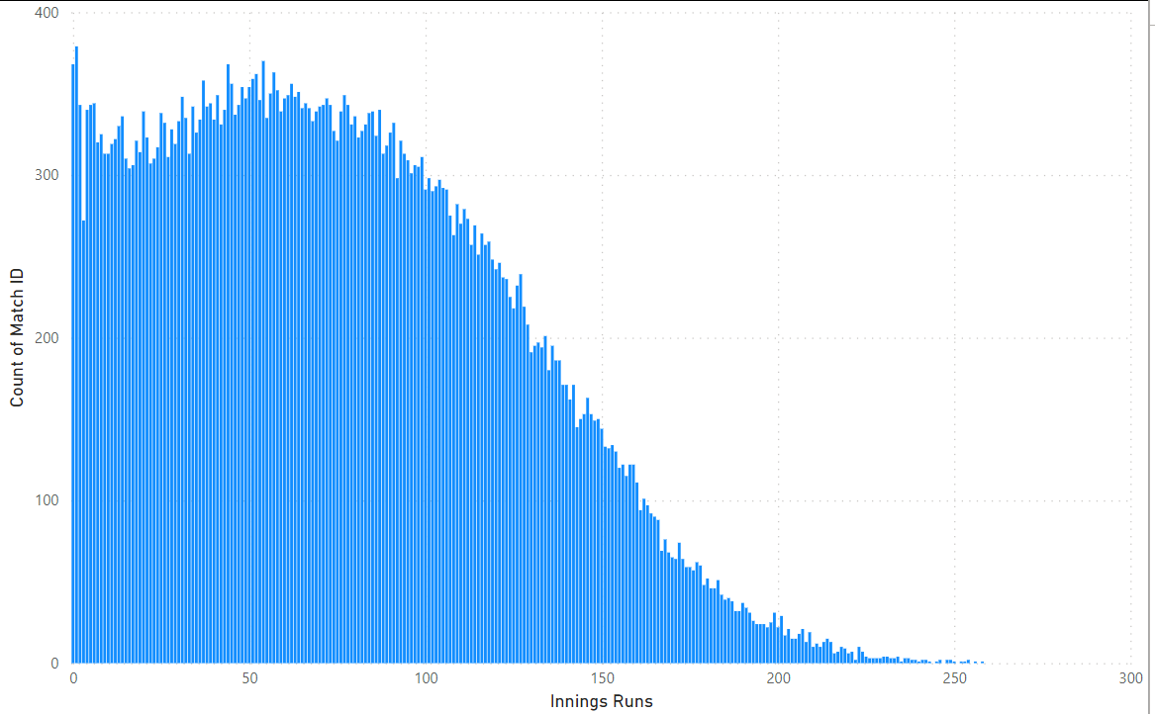
EDA – TABLEAU AND POWER BI

Slide 7
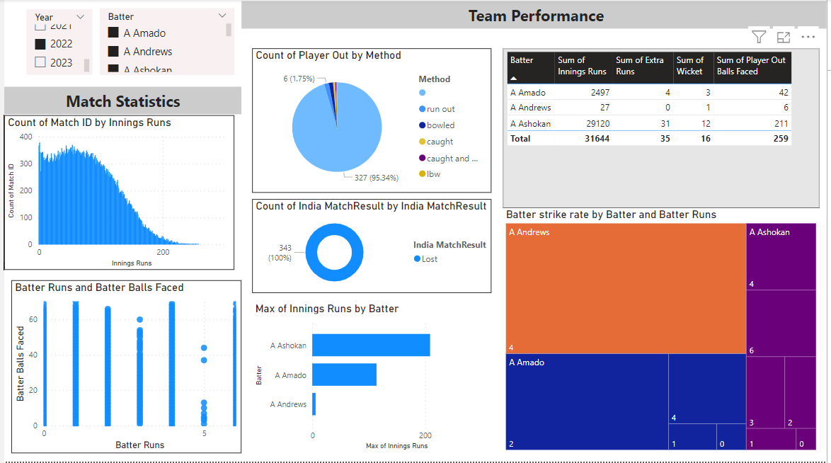
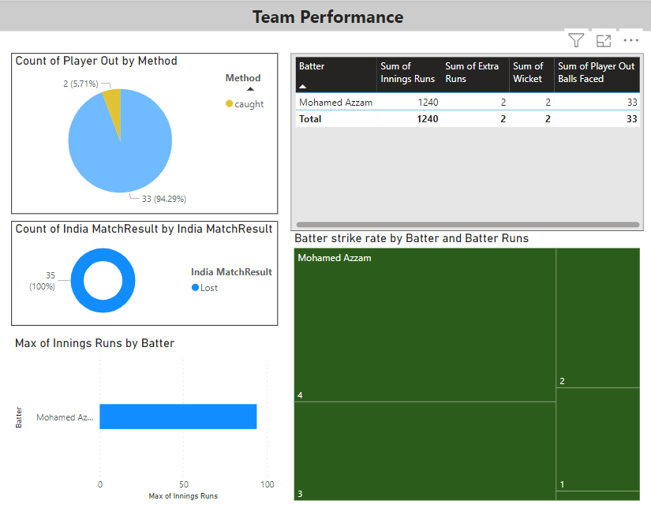
EDA – Tableau and Power BI

Slide 8
EDA – TABLEAU AND POWER BI

Slide 9
OVERVIEW - ML MODEL BUILDING
Python [PySpark]
Jupyter Notebook
Tableau
PowerBI
Programming Languages &
Programs/Tools
Binary Column for Player's Dismissal
Removing Outliers
Handling Missing Values
Date Conversion
Correlation Matrix
Data Cleaning
Linear Regression Analysis for Innings Runs Prediction
Logistic Regression for Second Innings Chasing Success Prediction
Predictive Models

Slide 10
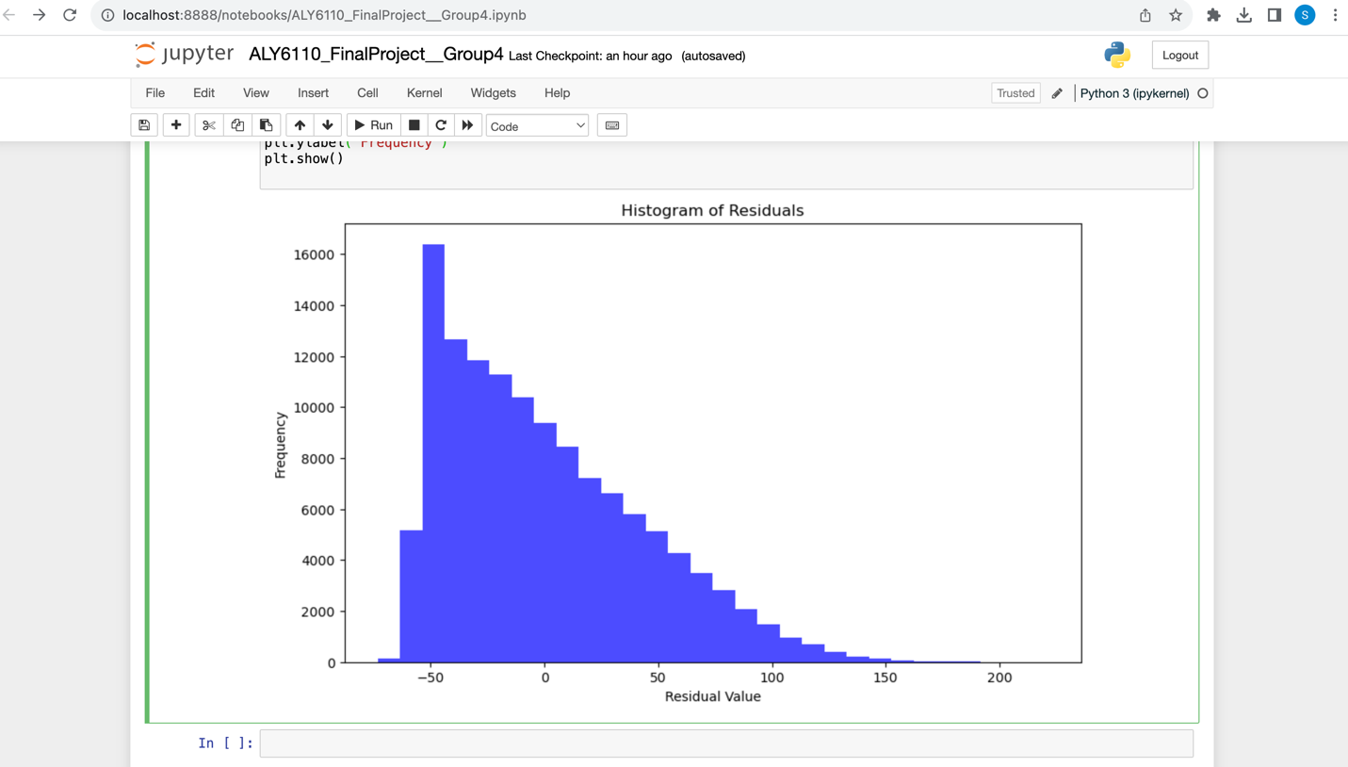
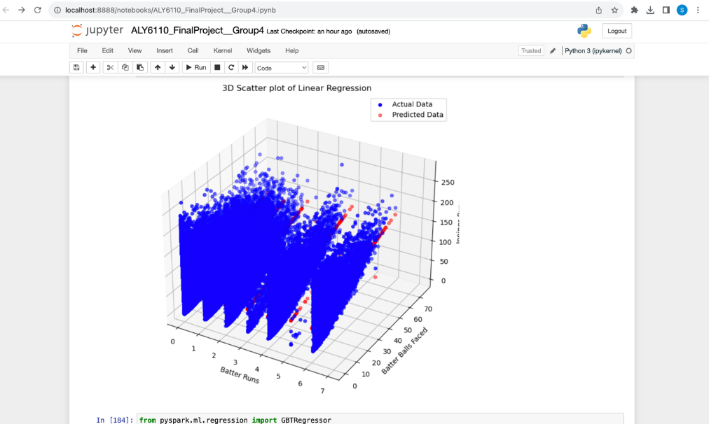
LINEAR REGRESSION ANALYSIS FOR INNINGS RUNS PREDICTION
Notes:
In the above case, a linear regression model has been chosen to predict "Innings Runs" based on the features "Batter Runs" and "Batter Balls Faced."
The distribution of residuals, or errors, from a regression model is shown in a residual histogram.
The discrepancies between actual and expected values are known as residuals. The suitability of the model and its underlying assumptions can be evaluated by examining the residual distribution.

Slide 11
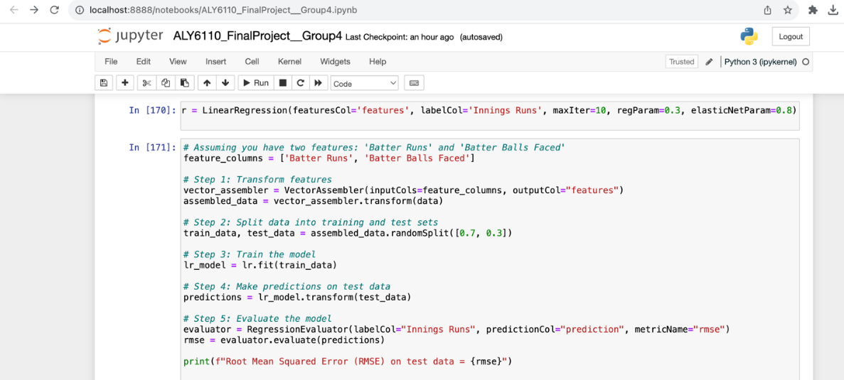
LINEAR REGRESSION ANALYSIS FOR INNINGS RUNS PREDICTION

Slide 12
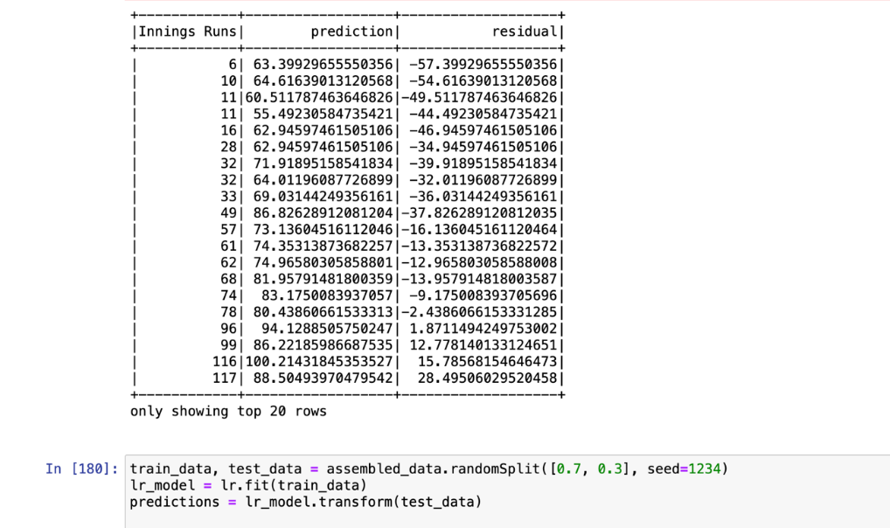
LINEAR REGRESSION ANALYSIS FOR INNINGS RUNS PREDICTION

Slide 13
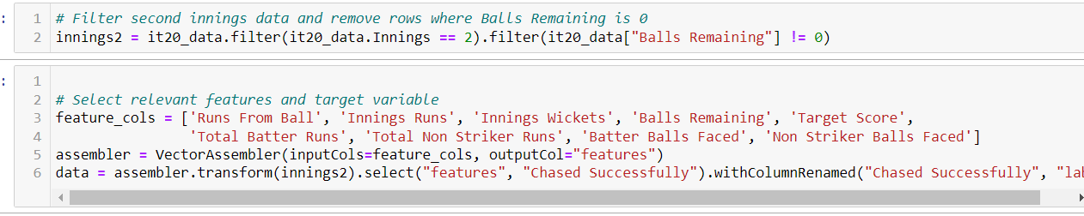
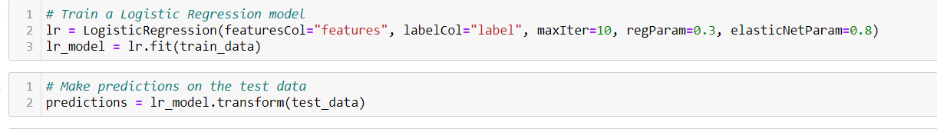
LOGISTIC REGRESSION FOR SECOND INNINGS CHASING SUCCESS PREDICTION

Slide 14
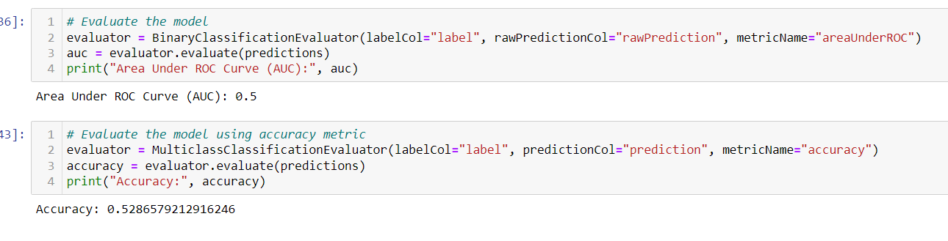
LOGISTIC REGRESSION FOR SECOND INNINGS CHASING SUCCESS PREDICTION
The AUC value of 0.5 reveals that the model, employing specific features and Logistic Regression, lacks predictive accuracy in determining successful chases in cricket. To enhance accuracy, future steps involve feature engineering, diverse algorithms exploration, and potential data incorporation, emphasizing continuous refinement for practical applicability.

Slide 15
CONCLUSION
Linear Regression (Innings Runs Prediction):
Impact: Empowering team management with precise player insights, aiding strategic decisions and enhancing fan engagement by unveiling detailed player contributions.
Logistic Regression (Match Outcome Prediction):
Impact: Illuminating successful chase patterns for strategic team decisions and enriching fan experiences, enabling more informed discussions.
Leveraging these models equips teams with actionable insights, elevating on-field performance. Simultaneously, fans gain deeper game understanding, fostering engaging interactions. Continuous model evolution ensures relevance in the dynamic T20 landscape.

Slide 16
THANK YOU

